Slide 1


Regulatory Challenges
in the Cryptocurrency Market:
Navigating Global Efforts and Market Stability
Presented by Sarah Hannouch
Course: SP25-FIN611852 Intro to Topics in Fin Tech
Professor Ajim Uddin, PhD

Slide 2


Introduction
Rise of digital assets like Bitcoin and Ethereum
Regulatory lag despite rapid market evolution
Aim of presentation: explore regulatory challenges, impacts on innovation & investor protection

Slide 3


Why This Topic Matters
Crypto is now mainstream — billions transacted daily
Growing concerns: fraud, manipulation, money laundering
Regulatory inconsistency across countries
Need to balance innovation with investor safety

Slide 4


Core Research Question
What are the major regulatory challenges in the crypto market?
How do they affect innovation and investor protection?
Exploring both risks and opportunities of regulation

Slide 5
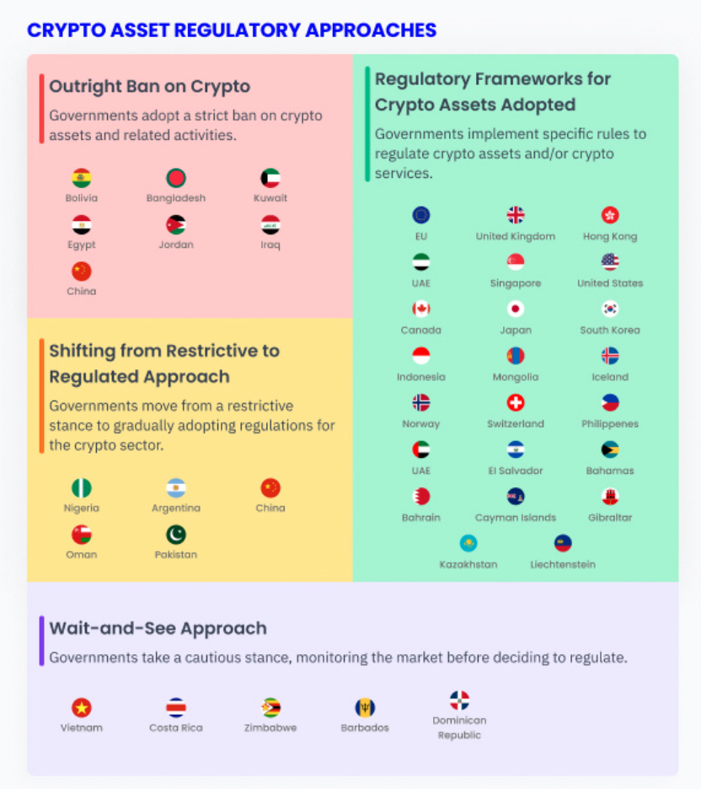
Literature Review Highlights
Decentralization complicates traditional oversight (Narayanan, Catalini)
Regulatory fragmentation creates confusion
Clear rules correlate with increased investor confidence
Oversight often lags behind fast-evolving tech

Slide 6

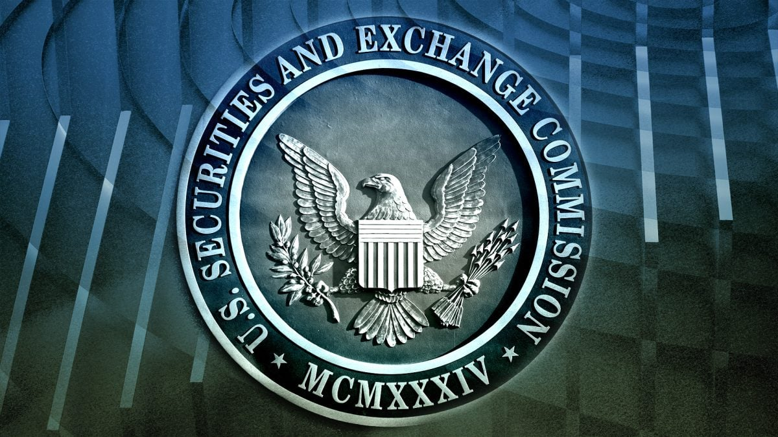
Data Sources
Market data: CoinMarketCap
Regulatory data: FATF, SEC reports
Exchange performance: Coinbase, Binance
Focus: responses to major regulatory events

Slide 7


Research Methods
Mixed-methods: qualitative + quantitative
Thematic analysis of regulatory documents
Time-series analysis of market cap changes
Focus on 48-hour window after policy events

Slide 8


Key Insights
Regulatory events trigger short-term market volatility
Clear frameworks attract innovation and capital
Harsh/vague policies drive away investors

Slide 9
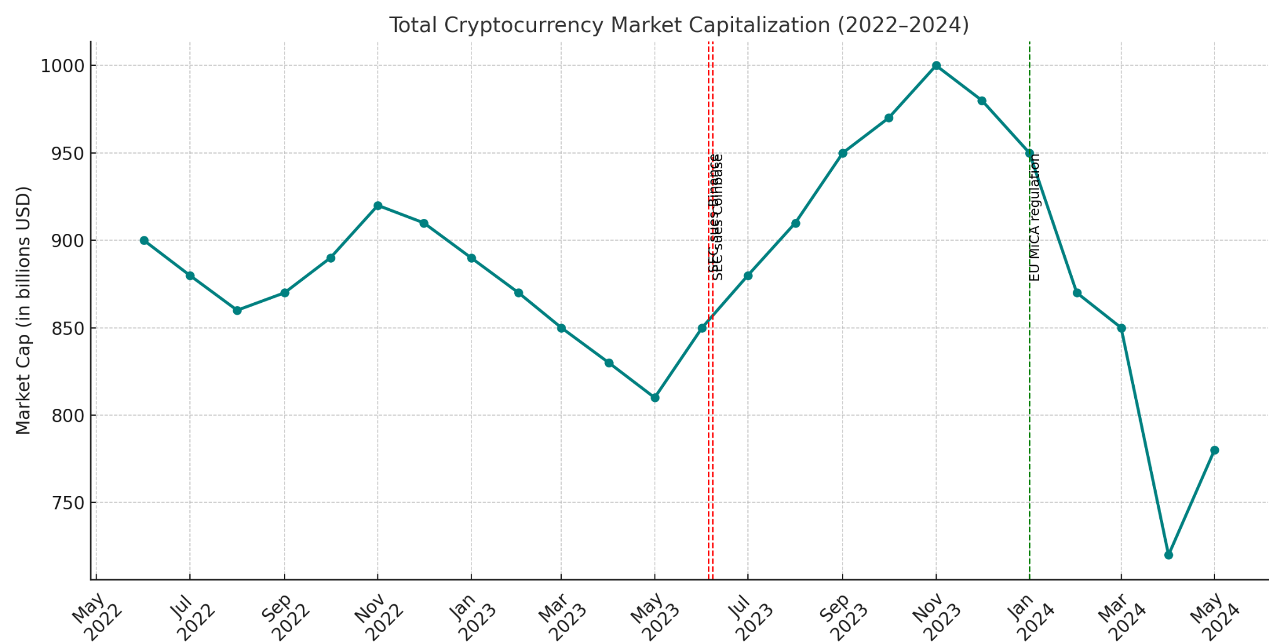
Crypto Market Cap & Regulation

Slide 10

What the Data Tells Us
Regulation adds legitimacy, but may deter innovation
Market reacts to tone, timing, and clarity of rules
Transparent rollouts stabilize investor sentiment
Policy announcements must be carefully communicated

Slide 11


Key Regulatory Hurdles
Jurisdictional gaps — crypto is borderless
Innovation outpaces regulation
Enforcement is difficult, especially offshore
Balancing growth with risk prevention is complex

Slide 12
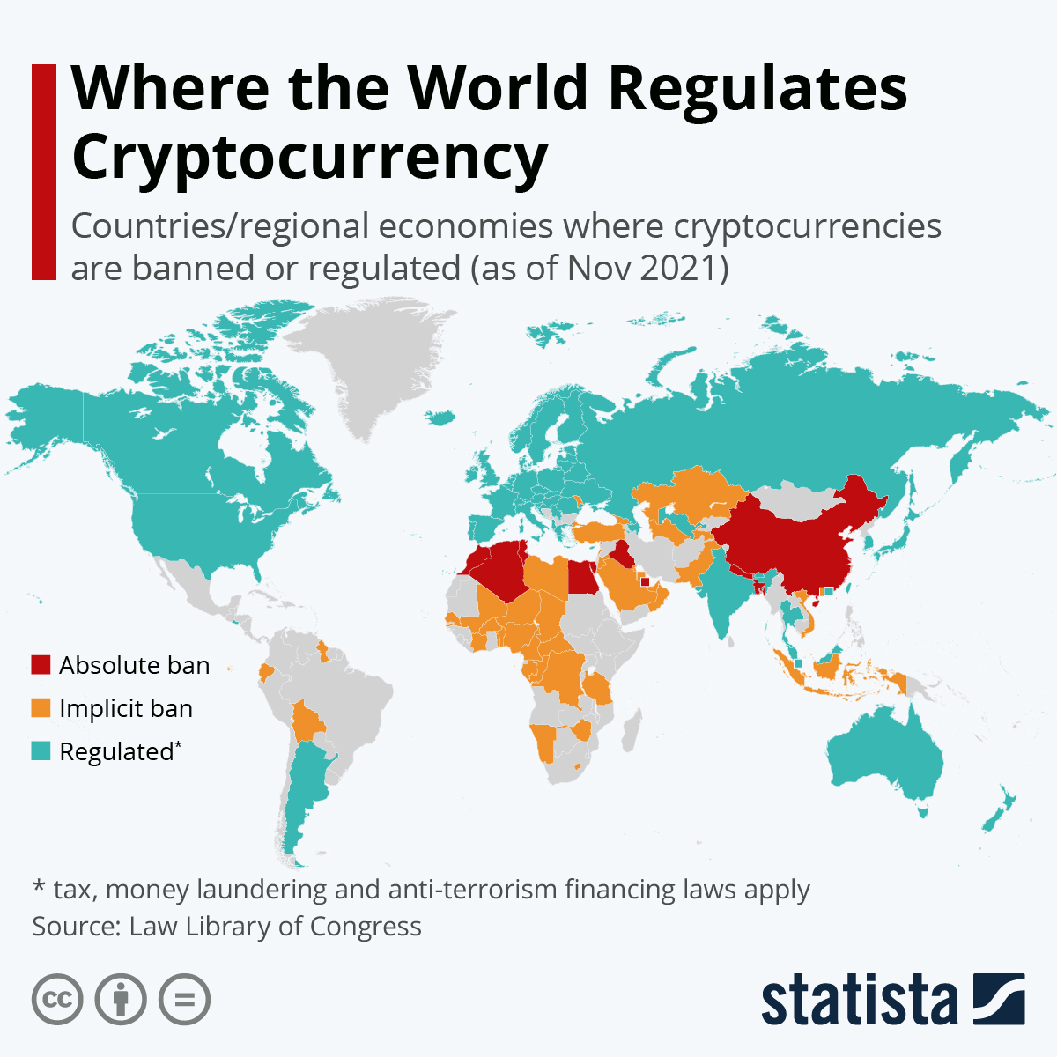
Comparing Global Approaches
U.S.: enforcement-heavy, unclear rules
EU: MiCA provides legal clarity
Asia: Japan & South Korea = structured; India = inconsistent
Regulatory clarity → stronger ecosystems

Slide 13
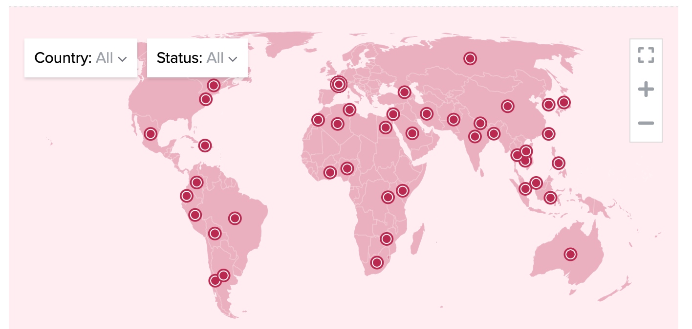
Where Do We Go From Here
Explore cross-border regulatory coordination
Study the impact of sandboxes & pilot programs
Link regulation to financial inclusion potential
Analyze long-term investor behavior

Slide 14


Final Takeaways
Regulation must balance innovation & protection
Clarity builds trust and attracts capital
The future of crypto depends on smarter, global policymaking

Slide 15
References
Financial Action Task Force (FATF). (2019). Guidance for a risk-based approach to virtual assets and virtual asset service providers. FATF.
Zohar, N. (2018). Regulation of cryptocurrencies: Opportunities and challenges. Journal of Financial Regulation and Compliance, 26(2), 233-251.
European Central Bank. (2020). Cryptocurrencies: A financial revolution. European Central Bank.

